Slide 1
Storage Class and User Defined Functions

Slide 2
Storage Class
Storage classes are used to define the scope (visibility) and life-time of variables and/or functions.
Every variable and function in C has two attributes: type and storage class.
There are four storage class
auto
static
extern / global
register

Slide 3
auto Storage Class
Variables declared within function bodies are automatic by default.
Declarations of variables within blocks are implicitly of storage class automatic.
The keyword auto can be used to explicitly specify the storage class. Eg: auto int a, b; auto char c=‘z’;
When a block is entered, the system allocates memory for the automatic variables. With in that block, these variables are defined and are considered “local” to the block. When the block is exited, the system releases the memory that was set aside for the automatic variables. Thus, the values of these variables are lost. If the block is reentered, the system once again allocates memory, but previous values are unknown.

Slide 4
static storage class
It allows a local variable to retain its previous value when the block is reentered. Eg: void fun (void) { static int ct = 0 ++ ct; if (ct % 2 == 0) . . . /* do something */ else . . . /* do something different */ }

Slide 5
extern storage class
When a variable is declared outside a function, storage is permanently assigned to it, and its storage class is extern.
Such a variable is considered to be global to all functions declared after it, and upon exit from the block or function, the external variable remains in existence.
One method of transmitting information across blocks and functions is to use external variables.
External variables never disappear. Because they exist throughout the execution life of the program, they can be used to transmit values across functions. They may, however, be hidden if the identifier is redefined.

Slide 6
#include<stdio.h> int a=1, b=2, c=3; //global variable int fun(); //prototype declare int main() { printf(“%3d%3d%3d\n”,a,b,c); //1 2 3 printf(“%3d\n”, fun()); //12 is printed printf(“%3d%3d%3d\n”,a,b,c); //4 2 3 } int fun() { int b,c; a=b=c=4; return(a+b+c); }

Slide 7
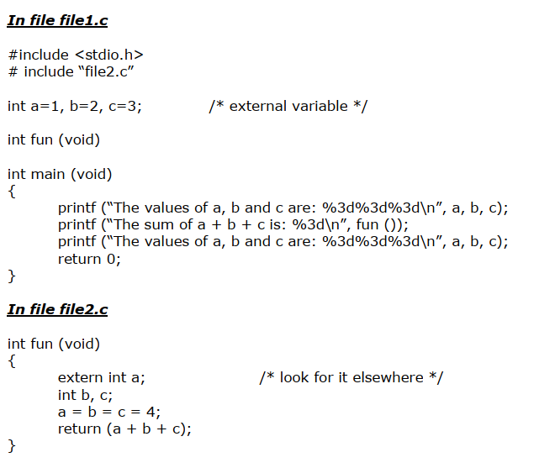

Slide 8
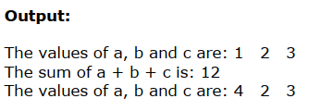

Slide 9
Something to note about extern class
Information can be passed into a function two ways: by use of external variable and by use of the parameter passing mechanism. The use of the parameter mechanism is the best preferred method. Don't overuse ‘extern’ variables. It is usually better to pass lots of arguments to functions rather than to rely on hidden variables being passed (since you end up with clearer code and re-usuable functions).

Slide 10
register storage class
This is like `auto' except that it asks the compiler to store the variable in one of the CPU’s fast internal register.
In practice, it is usually best not to use the `register' type since compilers are now so smart that they can do a better job of deciding which variables to place in fast storage than a user can.
When speed is a concern, the programmer may choose a few variables that are most frequently accessed and declare them to be of storage class register. eg: register int i; register int counter;

Slide 11
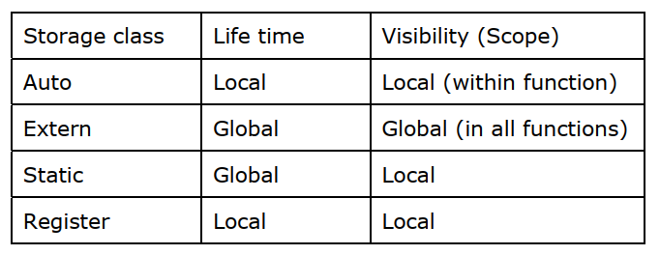

Slide 12
Functions
Functions are a group of statements that have been given a name. This allows you to break your program down into manageable pieces and reuse your code.
Function makes the lengthy and complex program easy and in short forms. It means large program can be sub-divided into self-contained and convenient small modules having unique name.
The length of source program can be reduced by using function by using it at different places in the program according to the user’s requirement.
By using function, memory space can be properly utilized. Also less memory is required to run program if function is used.
They also allow more than one person to work on one program.
Function increases the execution speed of the program and makes the programming simple.

Slide 13
Functions
Functions are classified into standard functions and user defined functions.
Standard Functions are also called library functions or built in functions.
All the standard functions such as sqrt(), log(), abs(), scanf(), pow() etc are provided in the library of functions.
User defined functions are set of codes written by the programmer to perform a specific task. These user defined functions serve additional functions than those available in the programming system.
We can write as many functions as we like as long as there is only one main() function. As long as these functions are saved in the same file, we do not need to include a header file.

Slide 14
Defining a function
type_specifier function_name ( formal_parameters ) { ….. body of the function
……. ……..
return (value)
}

Slide 15
Defining a function:
type_specifier specifies the type of value that the function's return statement returns. If nothing is returned to the calling function, then data type is void.
function_name is a user-defined function name. It must be a valid C identifier.
formal parameters is the type declaration of the variables of parameter list.
return is a keyword used to send the output of the function, back to the calling function. It is a means of communication from the called function to the calling function
note: the block between { and } is called the function block or body of the function.

Slide 16
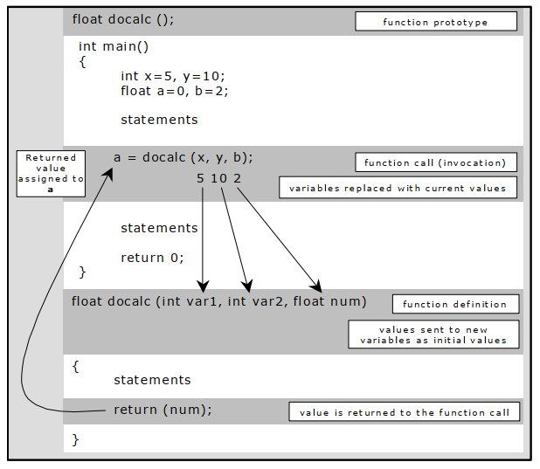
Context Switching
//Calling Function
//Called Function

Slide 17
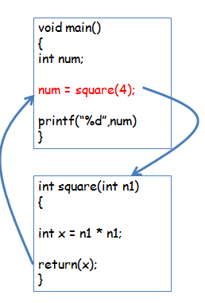

Slide 18
Demo of a simple program with function in class

Slide 19
Categories of functions
Functions with no arguments and no return value.
Functions with some argument and no return value.
Functions with no arguments and some return value.
Functions with some argument and some return value.
(demonstration of each category of function as part of classroom activity)

Slide 20
Things to note while working with functions
Parenthesis are compulsory after the function name.
The function name in the function call and the function definition must be same
The type, number, and sequence of actual and formal arguments must be same
A semicolon must be used at the end of the statement when a function is called.
The number of arguments should be equal to the number of parameters.
There must be one-to-one mapping between arguments and parameters. i.e. they should be in same order and they should have same data type.
Same variables can be used as arguments and parameters.

Slide 21
WAP to add two number from the user. Your program should have suitable implementation of functions.

Slide 22
Write a program to calculate the multiplication table of a number. Your program should ask the user for a number.

Slide 23
Write a program to read the age of the user. Your program should find whether the user is eligible to vote or not, using functions

Slide 24
WAP to read two values from the user and swap them using function.

Slide 25
WAP to create a simple calculator to perform addition, subtraction, multiplication and division. Your program should show the menu to the user before asking for the input.

Slide 26
WAP to convert the distance from km to miles and vice-versa. Make implementation of suitable user defined functions and show the user with menu to choose as follows: 1. Km to miles 2. Miles to KM (1 mile = 1.60 km)

Slide 27
Create a menu driven program to calculate the area of different shapes such as: 1. Rectangle 2. Square 3. Triangle 4. Circle Your program should ask appropriate input and calculate area for each shape selected by the user.

Slide 28
Parameters Passing in C
Arguments and parameters are the variables used in a program and in a function.
Variables used in the calling function are called arguments. These are written within the parentheses followed by the name of the function. They are also called actual parameters, as they are accepted in the main program (or calling function).
Variables used in the function definition are called the parameters. They are also referred to as formal parameters, because they are not the accepted values. They receive values from the calling function.
Parameters must be written within the parentheses followed by the name of the function, in the function definition

Slide 29
Parameters in C
A method of information interchange between the calling function and called function is known as parameter passing. There are two methods of parameter passing:
Call by Value
Call by Reference

Slide 30
Demonstration of each type of parameter passing method as part of classroom activity.

Slide 31
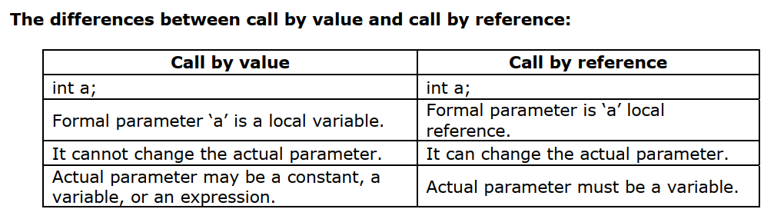

Slide 32
WAP to read two 4X4 matrices using functions. Your program should find the sum of these two matrices and display the result.

Slide 33
Passing Arrays in a Function
An array name represents the address of the first element in that array. So, arrays are passed to functions as pointers.
When a function is called with just the array name, a pointer to the array is passed.
In C, an array name without an index is a pointer to the first element. This means that the parameter declaration must be of a compatible pointer type.
There are three ways to declare a parameter which, is to receive an array pointer:

Slide 34
